Slide 1
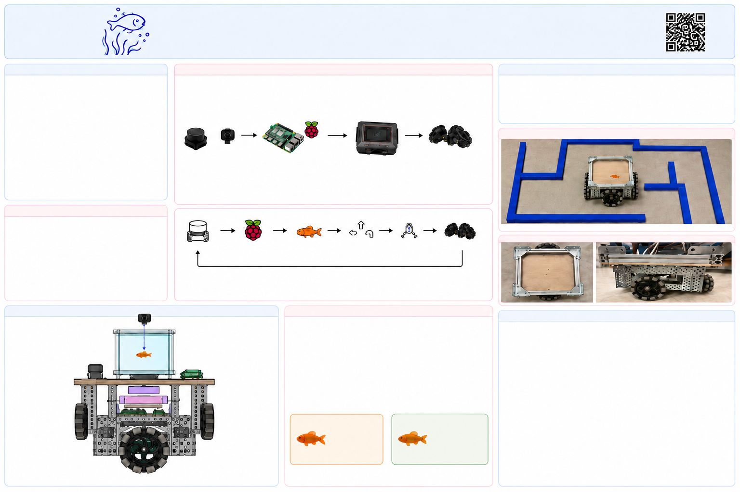

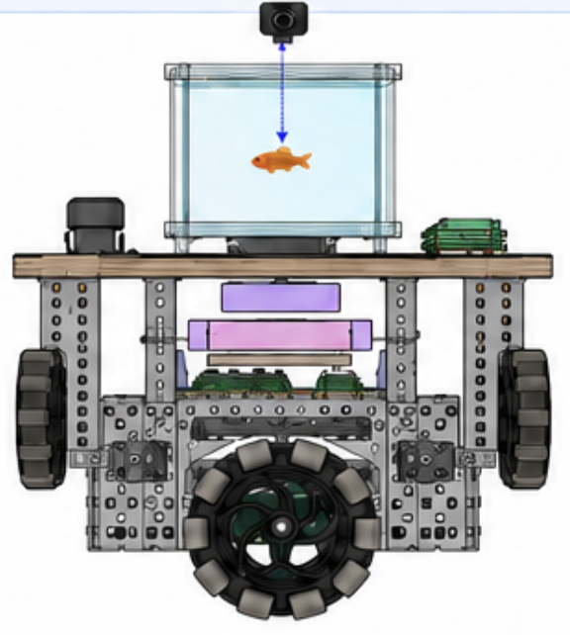
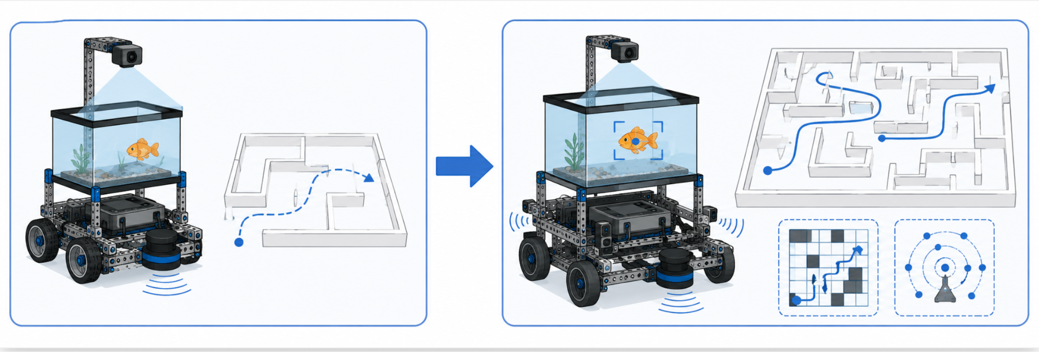
Navya Arora
Esha Madamalla
Madison Carney
Alexis Phan
GO FISH 2.0 – AUTONOMOUS FISH-FOLLOWING ROBOT
Systems & Ocean Lab - 2026
Yilmaz & Stickler
An autonomous robotics system that navigates a maze using LiDAR sensing and HSV color tracking to follow a fish target in real time.
Introduction
Methods
Results
Go Fish 2.0 is an autonomous robotics system that navigates a maze and follows a fish using LiDAR sensing and HSV color tracking. The Raspberry Pi processes LiDAR data to understand the robot’s surroundings and make movement decisions. An overhead camera tracks the fish using HSV color detection so the robot can follow it through the maze.
Goal: To build a robot that can autonomously navigate a maze and reliably follow a moving fish target in real time.
Sensing
Processing
Communication
Actuation
HSV tracking detected the fish target with a 91% average tracking rate.
The system responded to sensor input in real time, allowing the robot to correct its path.
Fish training trials showed that repeated food-based conditioning increased the fish’s movement toward the target area over time.
LiDAR (RPLiDAR A1) scans 360° to 8m range.
Overhead camera captures video of fish inside the tank.
Raspberry Pi reads LiDAR data and processes camera frames.
LiDAR data is processed to detect walls and obstacles.
HSV color tracking to locate the fish inside the tank.
The Pi decides the best movement toward the fish while avoiding obstacles.
Raspberry Pi sends simple commands to the VEX V5 Brain over serial USB.
Commands: FORWARD, LEFT, RIGHT, STOP.
VEX Brain receives commands and drives the motors.
Motors move the robot forward, turn, or stop.
GoFish 2.0 In Operation
LiDAR & Camera
Raspberry Pi 3
VEX V5 Brain
VEX V5 Motors
Novelty
Combines LiDAR sensing for obstacle detection with HSV color tracking for target following.
Modular design separating high-level computation (Raspberry Pi) from low-level motor control (VEX V5).
Cost-effective and scalable using accessible hardware and open-source software.
Capable of navigating complex environments while tracking a dynamic target.
LiDAR Scans
Pi Processes LiDAR and camera data
Pi detects fish using HSV
Pi decides movement
Command Sent to V5 Brain
Brain Drives Motors
Board Base
Repeats Continuously in Real Time
System Workflow
Full Robot Layout
Fish Behavior and Training Response
Impact and Future Work
The VEX chassis is the structural base.
Motors are mounted underneath the chassis to drive the robot.
A water tank sits on top of the upper platform; the fish is inside the tank.
The Raspberry Pi is mounted on the upper platform near the tank.
The VEX V5 Brain and battery are mounted lower in the chassis for stability.
The LiDAR is mounted with a clear 360° view of the environment.
The overhead camera is fixed above the tank and captures images/video of the fish inside the tank.
The robot is used as a training mechanism to test how fish respond to repeated food-based conditioning. Fish were trained to move toward food, and their movement patterns were observed as part of the oceanography component.
Fish showed stronger movement toward the food zone after repeated conditioning, suggesting early associative learning.
Shorter, more frequent sessions appeared to keep fish more responsive than longer sessions with breaks.
Applicable to search and rescue, environmental monitoring, and exploration in unknown environments.
Improve path efficiency with more advanced navigation strategies.
Add mapping and localization for larger, more complex mazes.
Enhance tracking with predictive algorithms for faster targets.
Incorporate additional sensors for improved robustness.
Group 1
Once weekly
10 min
with breaks
Group 2
Twice weekly
5 min
no breaks
These results help compare how different training schedules affect fish behavior and follow accuracy.

